Slide 1
Drawing with
Android Canvas
Jenelle C - W2019

Slide 2
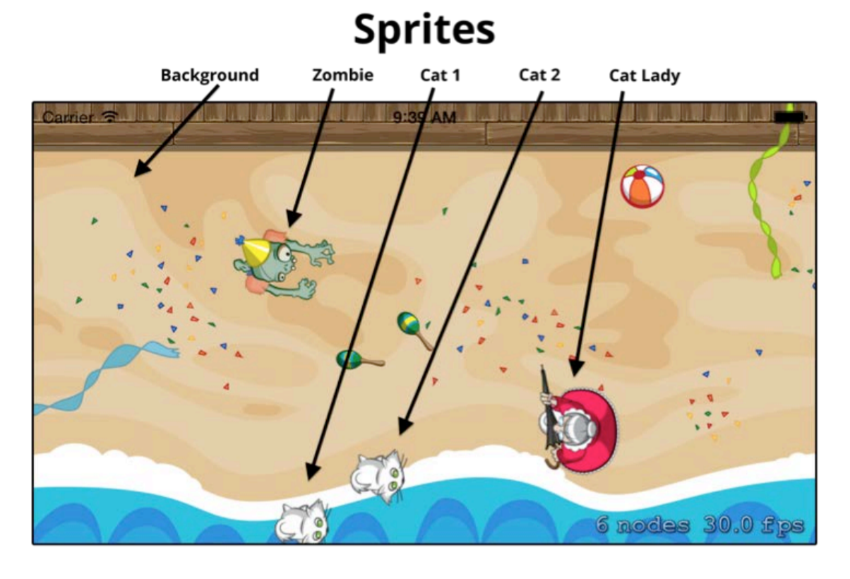
Objects on the screen are called “sprites”

Slide 3

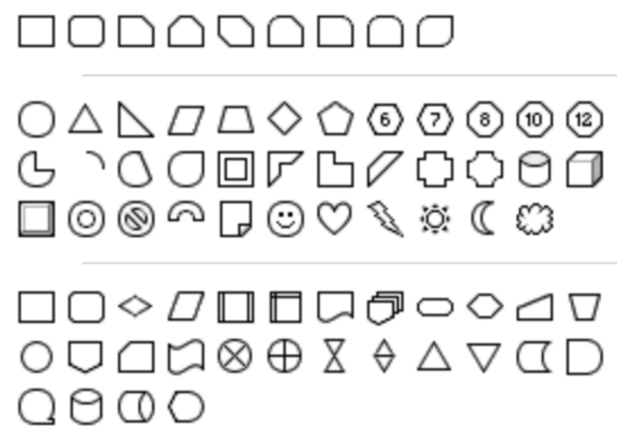
As a game developer, you can
Draw your own sprites
Use premade sprites
A graphics designer makes some pretty images for you
You “drag and drop” the images into the screen
Sprites can be premade image files or drawn in-game by Android
OPTION 1: Use premade image files
OPTION 2: Ask android to draw shapes, in-game

Slide 4
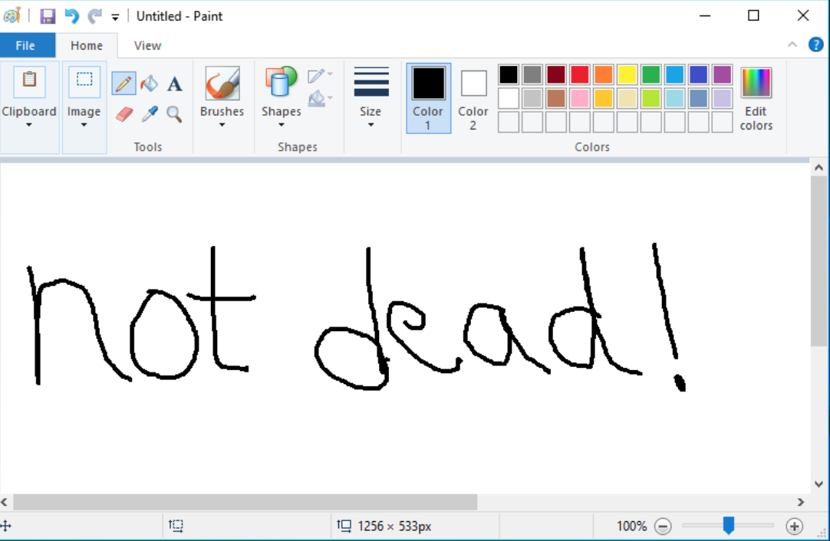

Slide 5
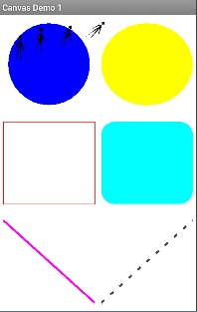
Android Canvas
Tutorials
Canvas from Scratch
https://code.tutsplus.com/tutorials/canvas-from-scratch-introducing-canvas--net-18290
Android Canvas Demo 1:
http://www.pp4s.co.uk/main/tu-oxygene-android-canvas1.html
A built in Java class used for drawing simple shapes and graphics.
How to draw?
By giving the Canvas class the (x,y) coordinate of the object you want to draw.

Slide 6
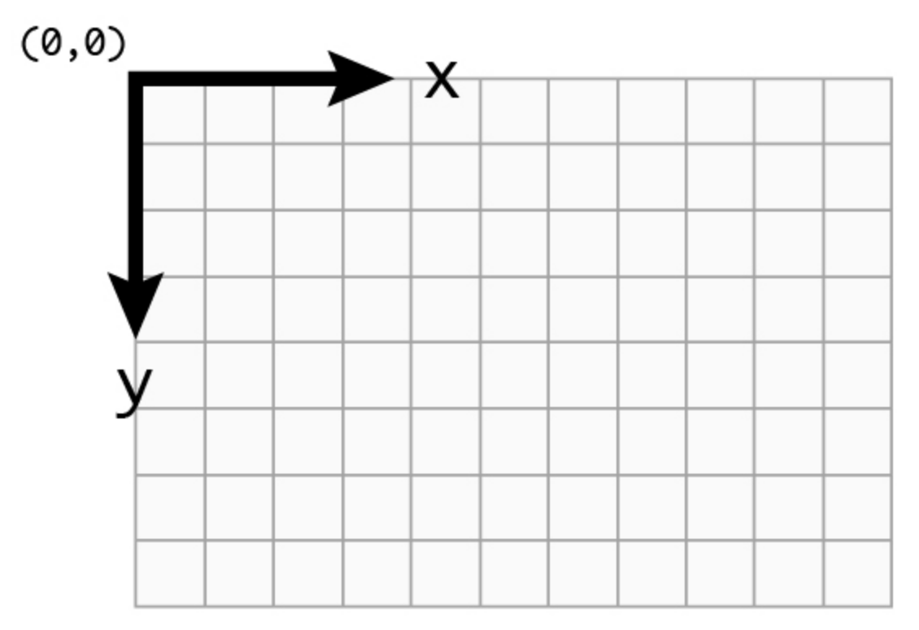
Coordinate Systems

Slide 7
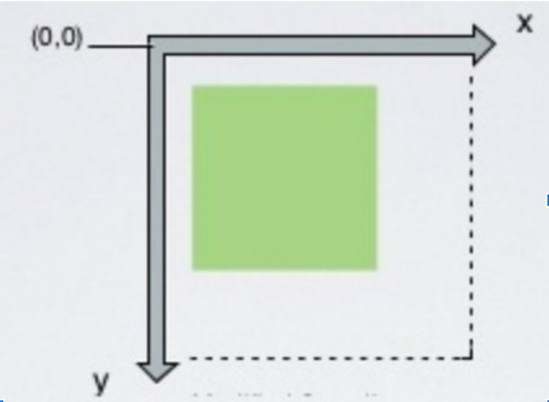
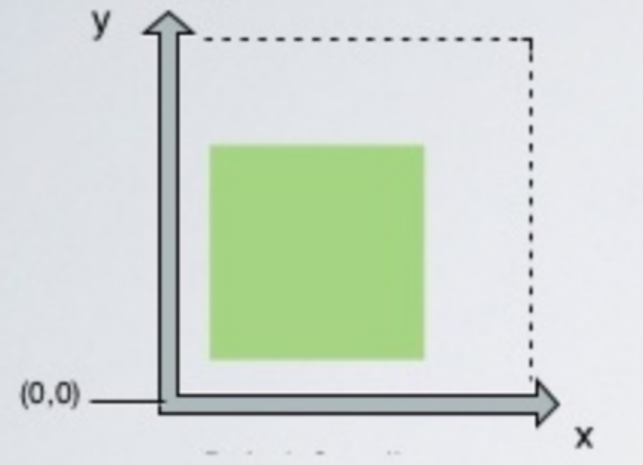
Important - IOS, SpriteKit, and Android have different ORIGIN points!
Android
UIKIT (normal IOS apps)
SpriteKit

Slide 8
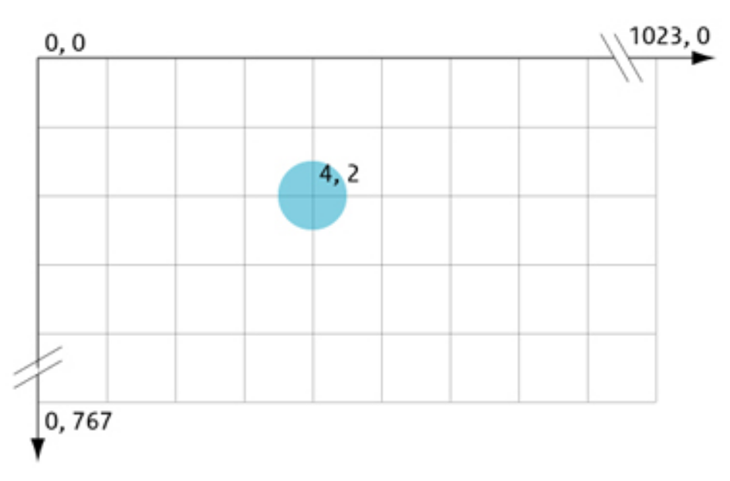
Example 1 - Drawing points (dots) on the screen:

Slide 9
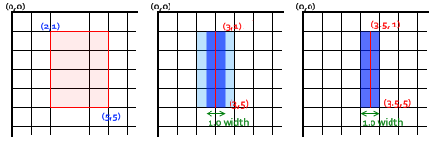
Example #2 - Drawing rectangles:
Tell Android the (x,y) coordinates of the top-left and bottom-right corners

Slide 10
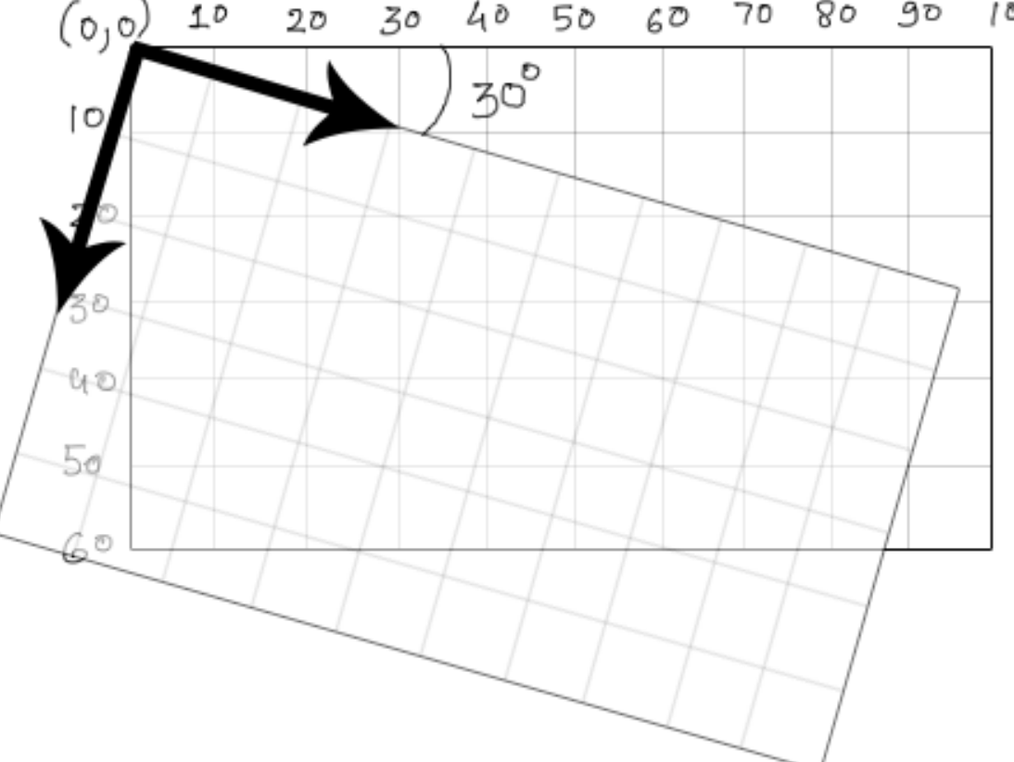
Example 3 - Rotating the canvas
You can also rotate the canvas by a certain amount

Slide 11
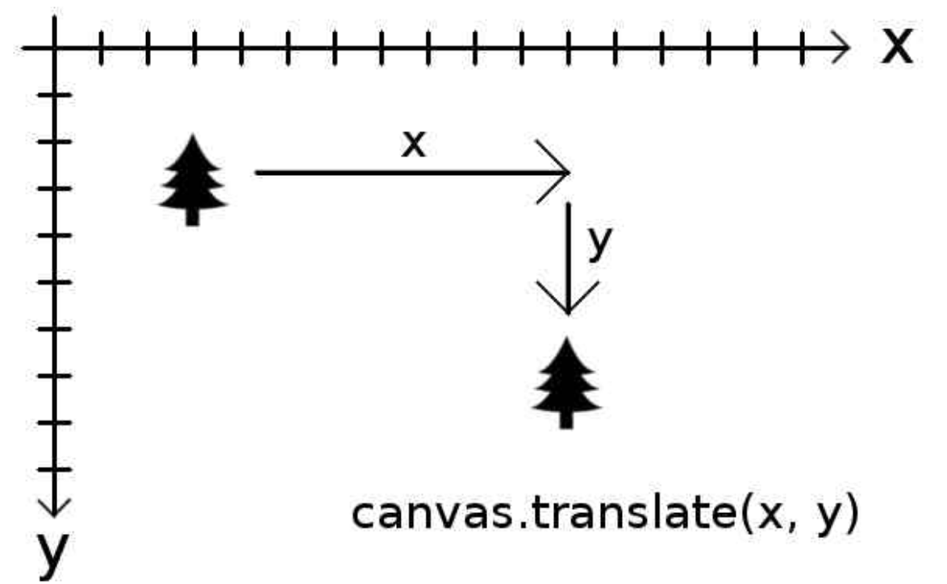
Example 4 - Moving shapes
Move a drawing to a new (x,y) position:

Slide 12
Using Canvas

Slide 13




To draw, you need:
Paintbrush
Colors
Canvas
(something to paint on!)
Frame
(something to hold your painting!)

Slide 14
In code, it looks like this:
tbd

Slide 15
Drawing Functions
Paint functions
setColor() | Set color of paintbrush
setTextSize() | Change font size of text
Canvas functions
drawColor() | Set background color
drawPoint() | Draw a “dot” on the screen
drawCircle() | Draw a circle
drawLine() | Draw a line
drawRect() | Draw a rectangle or square
drawText() | Put text on the screen

Slide 16
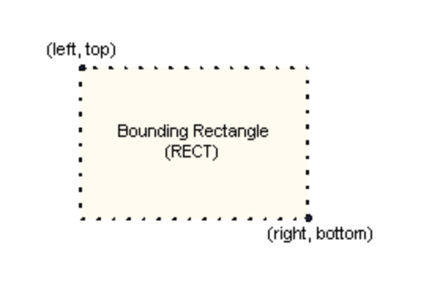
drawRect()
canvas.drawRect( left, top, right, bottom, paint )

Slide 17
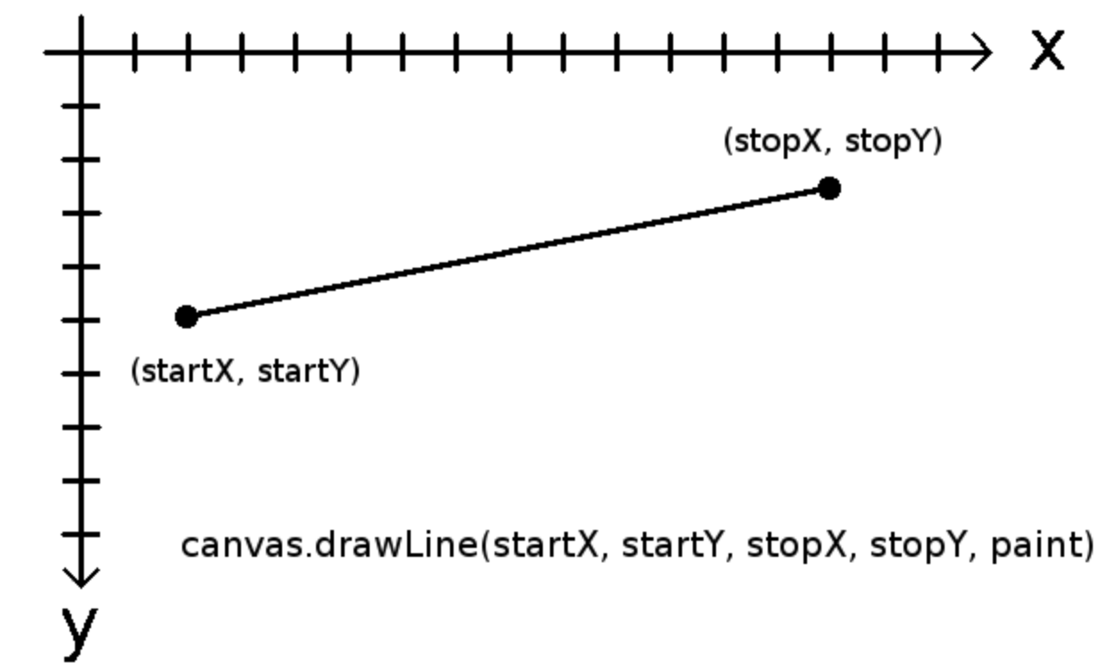
drawLine()

Slide 18

drawPoint()
canvas.drawPoint (float x, float y, Paint paint)
(x,y) position of where you want to draw the dot
(4,3)

Slide 19
drawCircle()
canvas.drawCircle(x, y, radius, paint);
radius
(x,y) = position of the MIDDLE of the circle
Radius = controls size of circle
(x,y)

Slide 20

setTextSize()
Sets the font size of text
Use a PAINT object, NOT canvas!

Slide 21
drawText()
canvas.drawText (String text, float x, float y, Paint paint)
(x,y) position of where you want to start writing
The message you want to write
(Example: “HELLO WORLD”
HELLO WORLD!

Slide 22
Demo - Using the Canvas

Slide 23
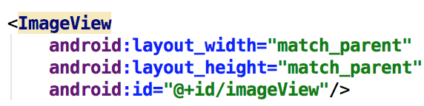
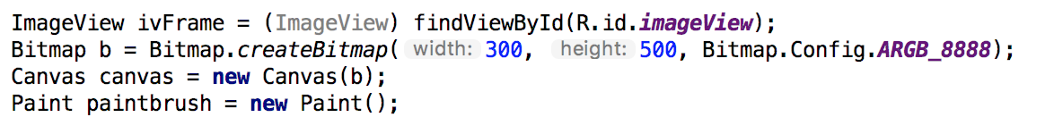
Project setup
Create new Android project
In activity_main.xml: Add a full screen ImageView
3. In MainActivity.java, create these objects inside onCreate()
ImageView
Bitmap
Canvas
Paint

Slide 24
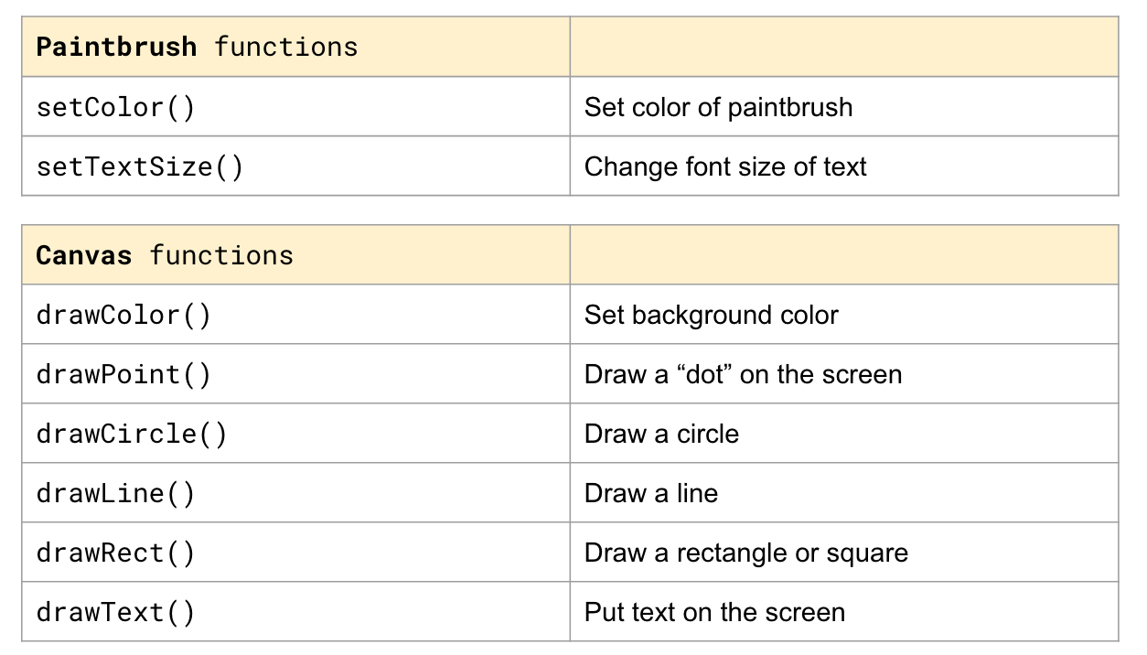
Project setup
4. Use the functions on slide 14 to draw things

Slide 25
5. At the end of your onCreate, put the image into the frame
ivFrame.setImageBitmap(b);
Completed Code:
https://bitbucket.org/jenelleteaches/android2d-canvasexample/src/master/

Slide 26
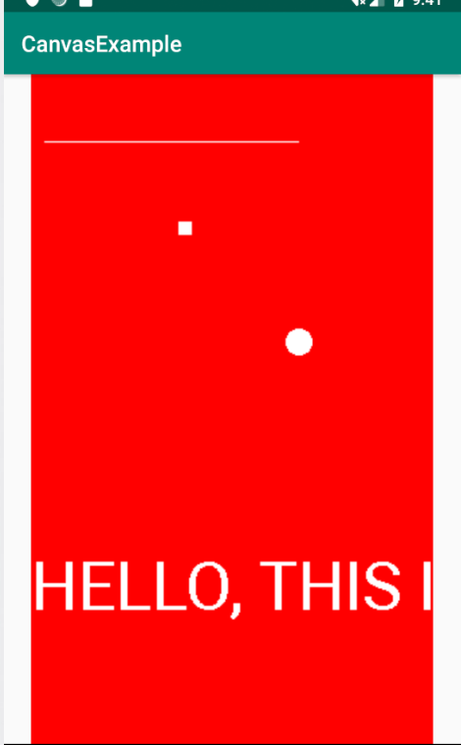
Expected Output
Red background,
White line
White square
White circle
White text that says “HELLO, THIS…”
Code to produce this output is on next page
Notes:
Opening preferences window - 20 sec

Slide 27
//@TODO: Setup your drawing tools
ImageView ivFrame = (ImageView) findViewById(R.id.imageView);
Bitmap b = Bitmap.createBitmap(300, 500, Bitmap.Config.ARGB_8888);
Canvas canvas = new Canvas(b);
Paint paintbrush = new Paint();
// @TODO: Set the color of your background & paintbrush
canvas.drawColor(Color.RED);
paintbrush.setColor(Color.argb(255,255,255,255));
// @TODO: Add your code to draw things
canvas.drawLine(10,50,200,50,paintbrush);
canvas.drawRect(110, 110, 120, 120, paintbrush);
canvas.drawCircle(200,200, 10,paintbrush);
// @TODO: Write some text on the screen
paintbrush.setTextSize(50);
canvas.drawText("HELLO, THIS IS A GAME!", 0, 400, paintbrush);
// @TODO: Put canvas in the frame
ivFrame.setImageBitmap(b);

